Slide 1


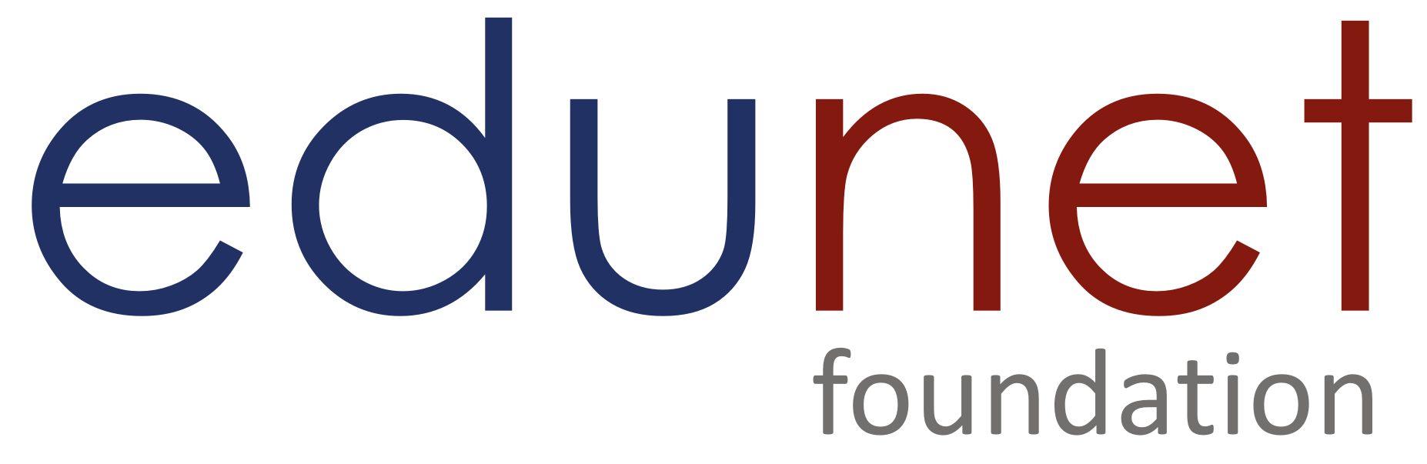

NEXT GEN EMPLOYABILITY PROGRAM
Creating a future-ready workforce
College Name
Student Name : HARISHNI D
Student ID :au814721104021
SRM TRP ENGINEERING COLLEGE

Slide 2

CAPSTONE PROJECT SHOWCASE
Project Title
Notes Sharing Web Application using Django Framework
Abstract | Problem Statement | Project Overview | Proposed Solution | Technology Used | Modelling & Results | Conclusion

Slide 3
Abstract
In the digital age, collaborative platforms are integral for efficient information sharing and collaboration. This project focuses on the development of a web application using the Django framework aimed at facilitating seamless note sharing among users
Key features include user authentication and authorization mechanisms to ensure data security and privacy, a rich text editor for creating and formatting notes, version control to track changes made to notes over time, and the ability to organize notes into categories or folders for easy access and managementThe development process involves designing an intuitive user interface, implementing robust backend functionalities using Django's powerful features such as ORM (Object-Relational Mapping), views, and templates, and deploying the application on a reliable web hosting platform. Additionally, considerations for scalability and extensibility are taken into account to accommodate future enhancements and increased user traffic.
Source :

Slide 4
Problem Statement
The primary objective of this project is to design, develop, and deploy a Note Sharing Web Application using the Django framework that addresses the following key challenges:
Inefficient Collaboration: Existing note-taking applications often lack robust collaboration features, making it challenging for users to share, edit, and collaborate on notes in real-time with others.
Security Concerns: Many note-taking platforms have security vulnerabilities that expose users' sensitive information to potential breaches, leading to privacy concerns and data leakage.
Limited Customization: Users often require customization options to tailor note organization, formatting, and sharing settings according to their specific preferences and workflow requirements, which are not adequately addressed by current solutions.
Compatibility and Accessibility: Accessibility across different devices and screen sizes is crucial for ensuring a seamless user experience. Existing applications may lack responsiveness or
Source :

Slide 5
Project Overview
Requirement Analysis:
Gather requirements from stakeholders to identify key features, user roles, and functionalities needed in the application.
Design and Planning:
Design the application architecture, database schema, and user interface layout based on the gathered requirements.Plan the project timeline, tasks, and resource allocation to ensure timely delivery.
Development:
Develop the application iteratively using the Django framework, following best practices for code organization, documentation, and testing.
Testing and Debugging:
Conduct comprehensive testing to identify and fix bugs, ensuring the application meets quality and performance standards.
Deployment:
Deploy the application on a production server, configuring settings for security, performance, and scalability.Monitor application performance and address any issues that arise during deployment.

Slide 6
Proposed Solution
User Authentication: Implementing secure registration, login, and logout functionalities.
Note Management: Enabling users to create, edit, delete, and organize notes. Utilize a rich text editor for formatting.
Real-time Collaboration: Integrating WebSocket technology for simultaneous editing by multiple users.
Sharing & Permissions: Allowing users to share notes with others, controlling access levels.
Responsive Design: Ensuring compatibility across devices for seamless user experience.
Deployment & Scalability: Deploy on reliable hosting, configure for security, performance, and scalability.
Source :

Slide 7


Technology Used
Front-end
Back-end
Source :

Slide 8
Modelling & Results
Our Note Sharing Web Application, built on the Django Framework, is structured around three primary models: User, Note, and Collaboration.
The User model includes attributes for username, email, and password, alongside methods for authentication and accessing shared notes.
Collaborations facilitate shared note interactions, allowing users to add or remove collaborators seamlessly. In terms of results, our application enables secure user registration and authentication processes, empowering users to create, manage, and collaborate on notes in real-time.
Owners maintain control over note access, while our responsive design ensures a consistent experience across devices. Deployed on reliable hosting platforms, our application offers scalability and smooth operation, supported by performance monitoring tools to guarantee optimal functionality."
Source :

Slide 9
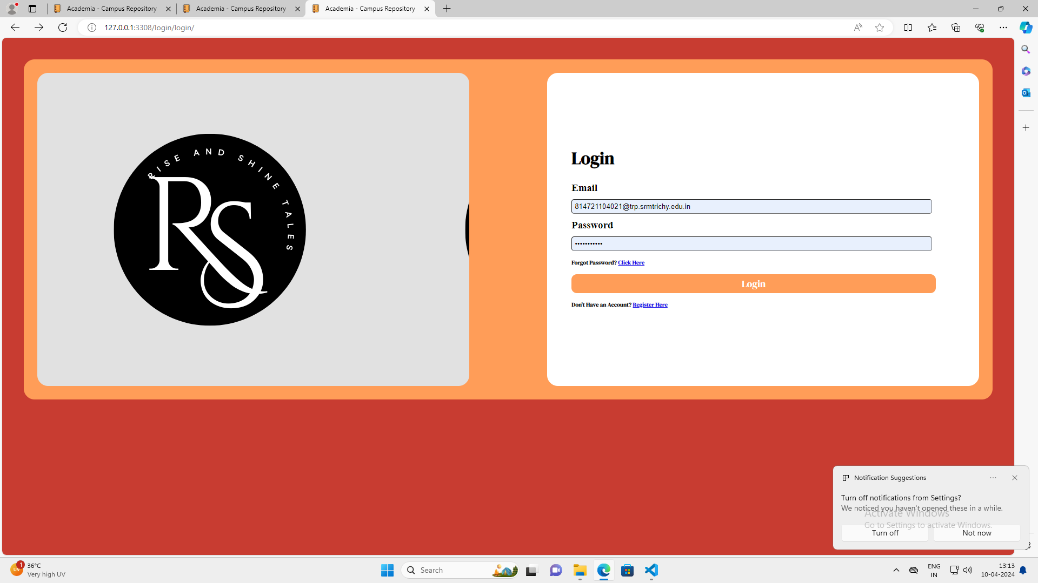
Homepage

Slide 10
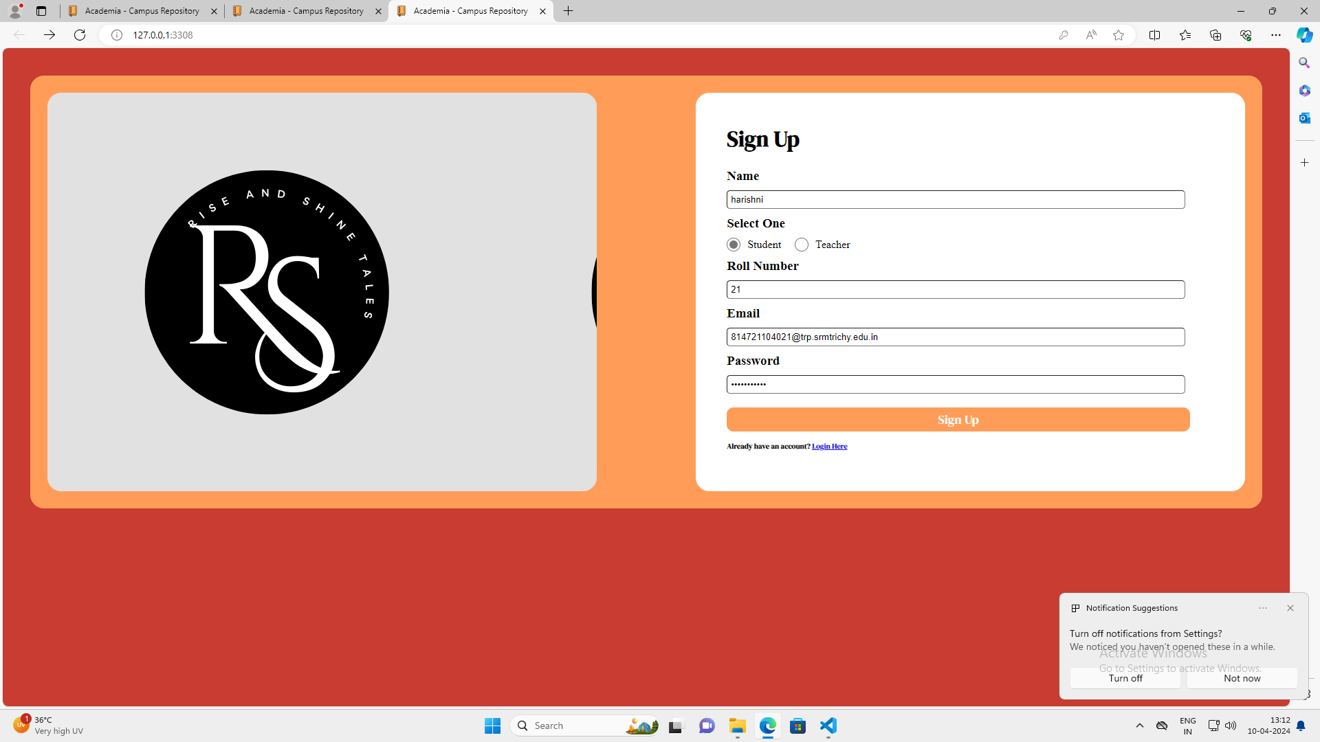
Student’s login

Slide 11
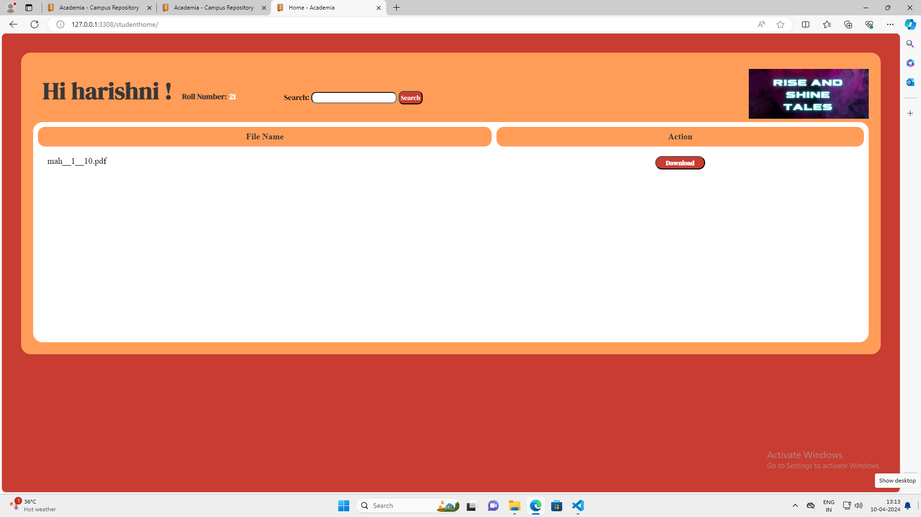
Student’s page

Slide 12
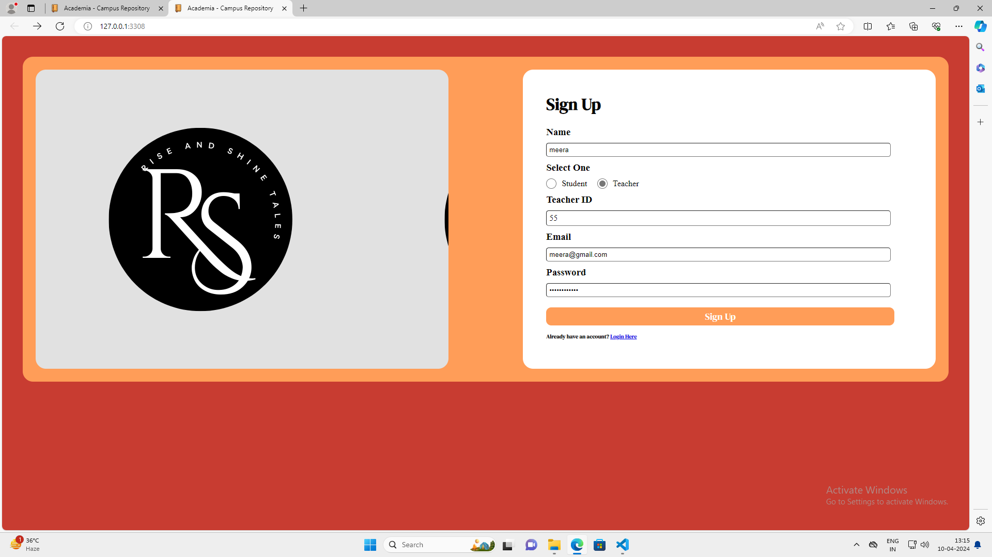
Teacher’s login

Slide 13
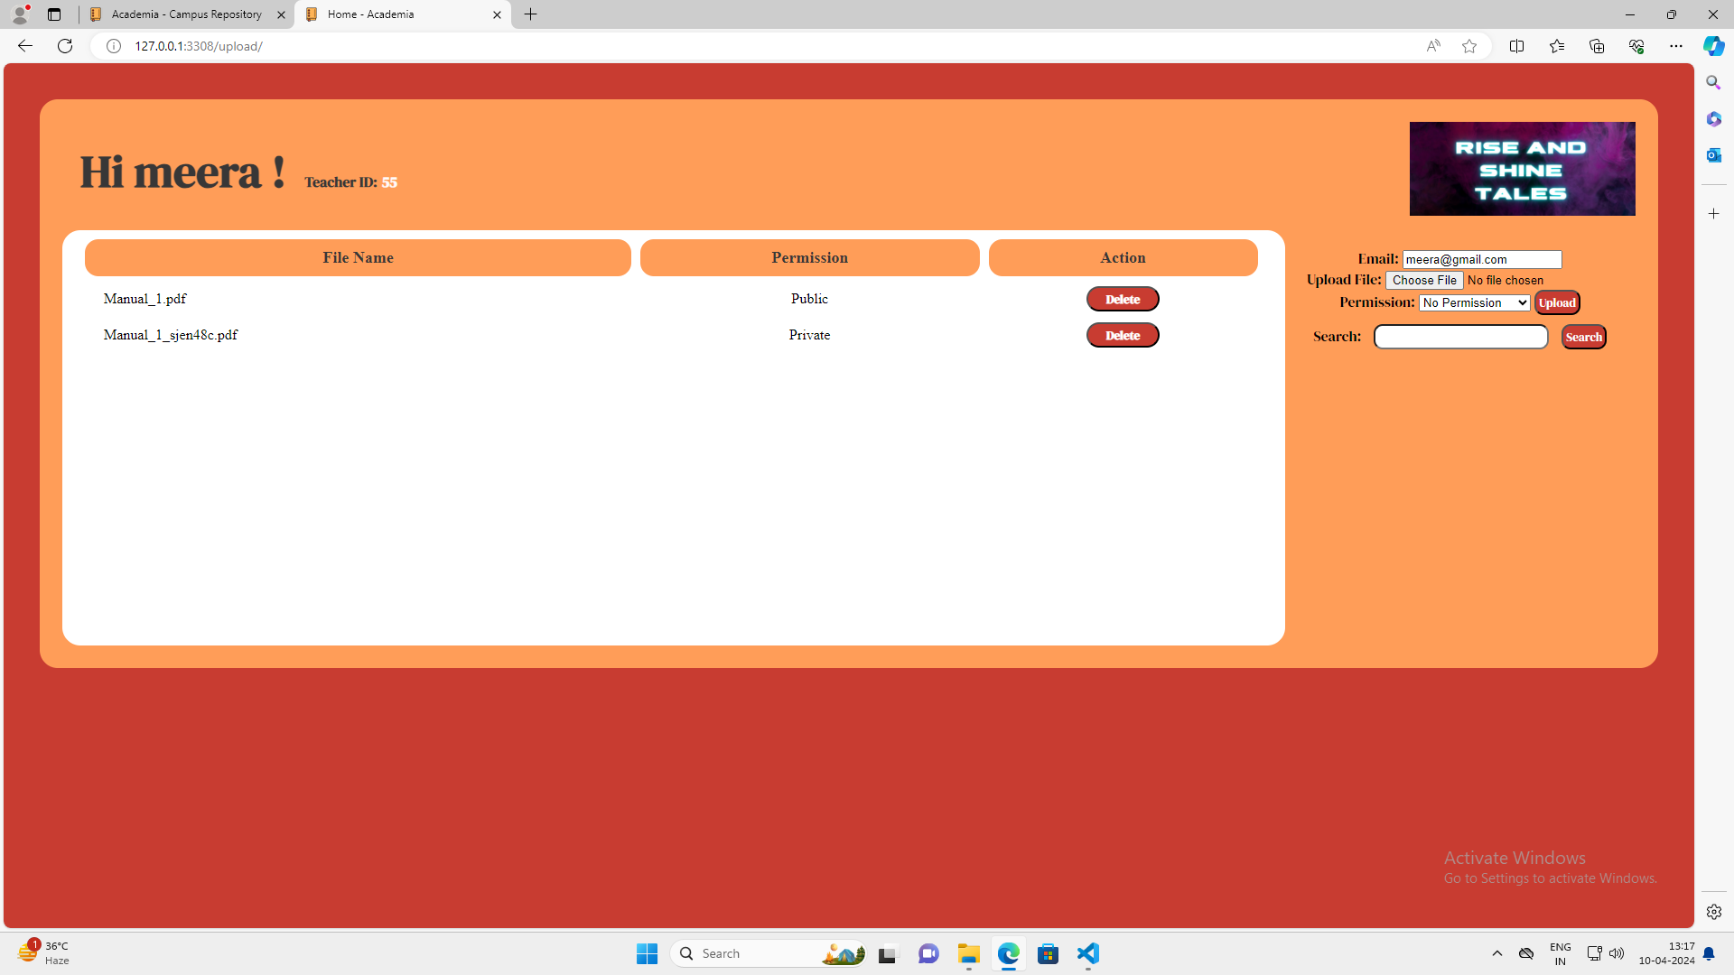
Teacher’s Page

Slide 14
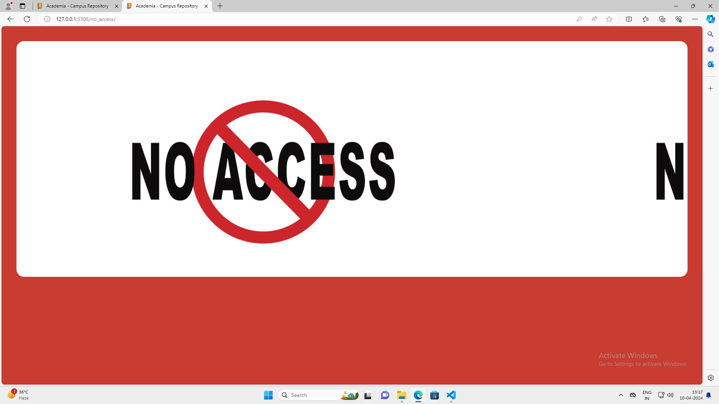
No Access

Slide 15
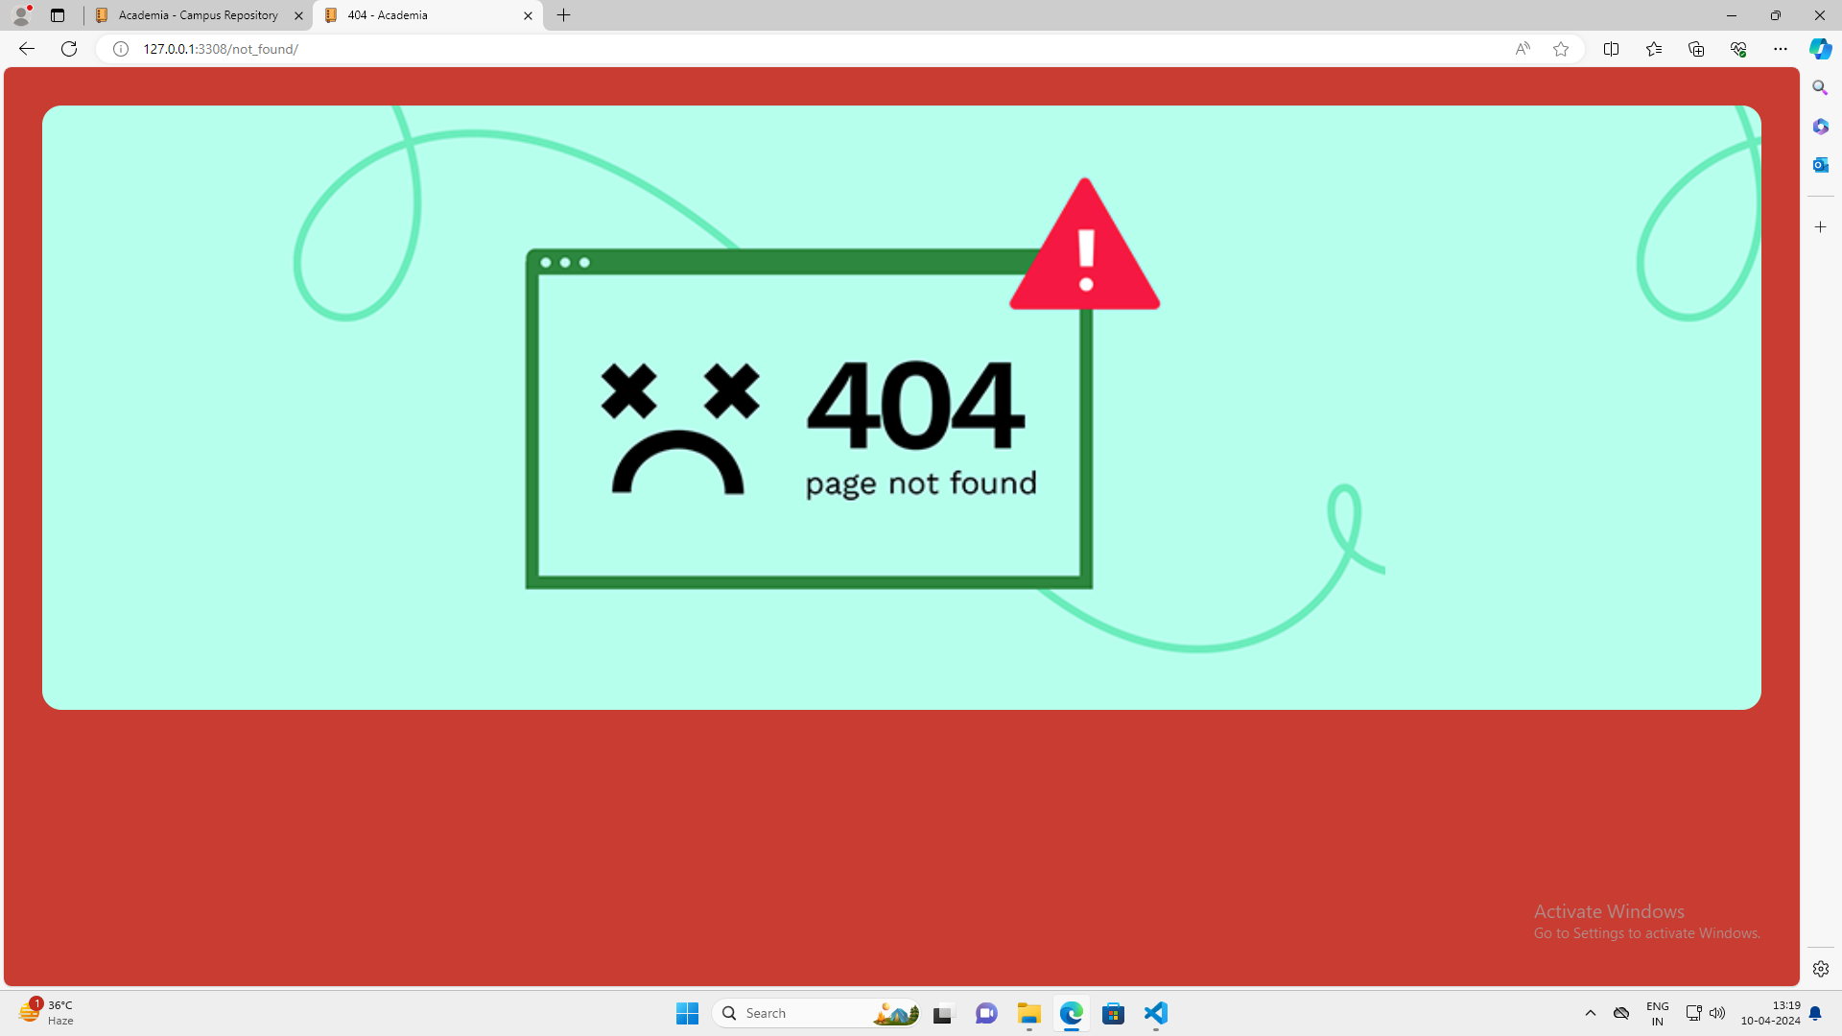
404 Error

Slide 16
Future Enhancements:
Integrating advanced collaboration features such as real-time chat functionality within shared notes could enhance communication among collaborators, facilitating seamless discussions and brainstorming sessions.
Implementing support for file attachments within notes would allow users to include relevant documents, images, or other media, further enriching the content and utility of shared notes.
Furthermore, introducing advanced search and filtering capabilities would empower users to efficiently navigate through their notes, enabling them to locate specific information quickly.
Another avenue for enhancement lies in the implementation of user-friendly analytics tools, providing insights into note usage patterns, collaboration dynamics, and other relevant metrics, thereby enabling users to optimize their workflows and productivity.
Lastly, exploring integration with third-party services or APIs, such as cloud storage platforms or productivity tools, could provide users with seamless integration and enhanced functionality.

Slide 17
Conclusion
In conclusion, our Note Sharing Web Application developed using the Django Framework represents a significant step forward in facilitating seamless collaboration and information sharing among users.
Through the implementation of robust user authentication, real-time collaboration features, and intuitive note management functionalities, we have created a platform that empowers individuals and teams to work together efficiently and effectively.
By leveraging Django's capabilities and adhering to best practices in web development, we have ensured the application's security, scalability, and performance
Looking ahead, future enhancements such as advanced collaboration features, file attachments, and analytics tools hold promise for further enriching the application's capabilities and user experience.
Ultimately, our Note Sharing Web Application serves as a valuable tool for fostering productivity, knowledge sharing, and collaboration in both personal and professional contexts, making it a valuable asset in the digital age.

Slide 18
Thank You!
Notes:
Thank You !!

